Slide 1
Microsoft Teams
Chiamate e Meeting

Slide 2
Panoramica servizi voce
Notes:
If you do not have a foundation in telecommunications it is highly encouraged you take the time to familiarize yourself with the below terminology that is used in the telecommunications industry.
Basic Telephony Terminology
PSTN Public Switched Telephone Network
The public telephone network to which telephones, ACDs, and PBXs are connected. Also known as the network cloud.
Centrex
Centrex is a single line service delivered to individual desks/users with added features. Centrex is an alternative to buying/leasing a PBX or key system and is often most cons-effective for very small sites and very large campuses. Call handling with Centrex is virtually the same as with a PBX except that most of the components are in the central office.
Switch
A telephone exchange (US: telephone switch) is a piece of equipment that connects phone calls. It is what makes your phone calls "work" in the sense of making connections and relaying the speech information
Central Office
Phone company facility where subscribers lines are joined to switching equipment for connecting subscribers to each other, locally or long distance.
Private Automatic Branch Exchange (PABX, PBX)
PBX
A premise based solution (as opposed to central office hosted) that is owned/leased by the customer and is a smaller version of a telephone company central office switch. The PBX switches or connects lines to trunks. It has an attendant to provide serve to a number of individual phones, such as in a hotel, university, business, or government office. Most PBXs can support up o thousands of users and can be networked to other PBXs (of the same vendor type) to provide some level of transparency between locations and ease of use.
Trunk
A physical link (wire, optical line, and so forth) between telephone exchanges (switches)
TDM
A technique for transmitting a number of separate data, voice, and /or video signals simultaneously over on communications medium. In TDM, you sample each voice conversation (8000 samples per second), interleave the samples, send them on their way, and then reconstruct the conversations at the other end. Each sample is transmitted at a different moment in time and consumes the entire bandwidth of the pathway for that moment. TDM can be used for either analog or digital transmission. One measure of capacity in a system (e.g. T1) is the number of simultaneous conversations (timeslots) it can handle (create). The basic goal of time division multiplexing is to save money-put more conversations onto fewer lines/pathways.
VoIP
IP Telephony, also called 'Internet telephony', is the technology that makes it possible to have a telephone conversation over the Internet or a dedicated Internet Protocol (IP) network instead of dedicated voice transmission lines
CSTA over SIP
Computer Supported Telecommunications Applications (CSTA) In short, A standards-based protocol-level integration
ISDN
Is a digital standard used mainly in the US between PBXs and other PBXs, ancillary equipment or PSTN, additionally ISDN phones are widely used in Europe.
Integrated Services Digital Network (ISDN) is a type of circuit switched telephone network system, designed to allow digital (as opposed to analog) transmission of voice and data over ordinary telephone copper wires, resulting in better quality and higher speeds, than is capable with analog systems. More broadly, ISDN is a set of protocols for establishing and breaking circuit switched connections, and for advanced call features for the end user.
Pulse Code Modulation (PCM)
Legacy signaling standard
Dual-tone multi-frequency (DTMF),
also known as Touch Tone® is used for telephone signaling over the line in the voice frequency band to the call switching center. DTMF is an example of a multi-frequency shift keying (MFSK) system. Today DTMF is used for most call setup to the telephone exchange, at least in the Western world, and trunk signaling is now done out of band using the SS7 signaling system. The trunk signaling tones were different than the tones known as touch tone with a triangular matrix being used rather than a square matrix. See: blue box for more details on the switching tones.
Prior to DTMF the phone systems had used a series of clicks on the phone line to dial numbers, a system known as pulse dialing. The clicks were actually the connection of the calling party's phone line being made and broken, like flicking a light switch on and off. This was useful only as far as the local end office where the wires stopped, requiring operator intervention for long distance dialing.
CTI
Computer telephony integration, also referred to as CTI, is technology that allows interaction on a telephone and a computer to be integrated or coordinated.
Third-party-call-control
Third party call control generally requires a dedicated Telephony Server to interface between the telephone network (PBX) and the computer network.
Caller ID (Caller Identity Display or CID) is a telephony network service that transmits the caller's telephone number to the called party's telephone equipment during the ringing signal or when the call is being set up but before the call is answered. Typically, CID is transmitted digitally between the first and second rings.
Caller ID is also known as Calling Line Identification (CLI) when provided via an ISDN connection to a PABX, while in some countries, the terms Caller Display, Calling Line Identification Presentation (CLIP) or just Calling Line Identity (CLID) are used. CID originated with automatic number identification (ANI) in the U.S.
ANI Automatic Number Identification
A system utilized by telephone companies to identify the directory number (DN) of a calling subscriber. Similar to Caller ID, but based on different underlying technology. Though subscribers can block Caller ID, ANI is usually impossible to block. ANI data is usually transmitted in-band using multi-frequency signaling.
DNIS Dialed Number Identification Service
A feature that identifies the phone number the caller dialed to reach the answering telephone system. May be a number translation, depending on the dialing plan.
DN
Directory Number (VDN, CDN, etc vendor specific) think in terms of this being an extension/telephone/user
E.164
A 16-digit numbering scheme that provides a unique telephone number for every subscriber in the world. Think of this as the “telephone number”.
IP-to-PSTN Gateway
Aka IP Gateway. A bridge between traditional circuit-switched telephony and the internet that enables IP based solutions to connect to the PSTN network
SIP URI
SIP Uniform Resource Identifier. The SIP URI used in the configuration of Communicator contains the users phone number or extension along with the phone domain for the PBX to which they are associated
Example: +16504665120@DCOAlcatelA4400.genesyslab.com
TEL URI
Telephony Uniform Resource Identifier

Slide 3
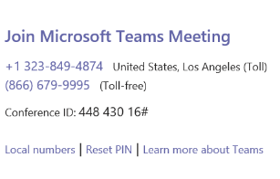
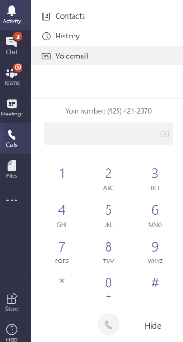
Microsoft Teams servizi voce
Audio Conferencing
Audio Conferencing
Utilizzare un numero di accesso esterno a pagamento per partecipare alle riunioni da qualsiasi dispositivo
Chiamata in uscita per aggiungere i partecipanti alla riunione
X
Phone System
  Gestire centralmente gli utenti per comunicazioni, posta elettronica e contenuto da Office 365
  Sostituisce i sistemi telefonici PBX con una soluzione nel cloud
Calling Plan
Calling Plan
  Abbonamento ai piani di chiamata da Microsoft 365
  Utilizzare i numeri di telefono esistenti o ottenere dei nuovi numeri
Phone System

Slide 4
Che cos’è l’ Audio Conferencing?
Audio Conferencing tramite Microsoft 365
Microsoft fornisce ora servizi di Dial-in e Dial-out in Microsoft Teams che una volta erano abilitati da provider di terze parti, consentendo ai partecipanti di accedere alle riunioni di Teams praticamente da qualsiasi dispositivo.
  Included in Conferencing subscription
  Communications Credits Required
  Microsoft Teams
  online meeting
  Attendees dial-in
  Attendees Toll-free
  dial-in
  Meeting organizer
  Dial out to attendees
  in Zone A/Included countries¹
  Dial out to attendees
  in PAYG countries
See availability of Audio Conferencing by country here
See Included (Zone A) countries here

Slide 5
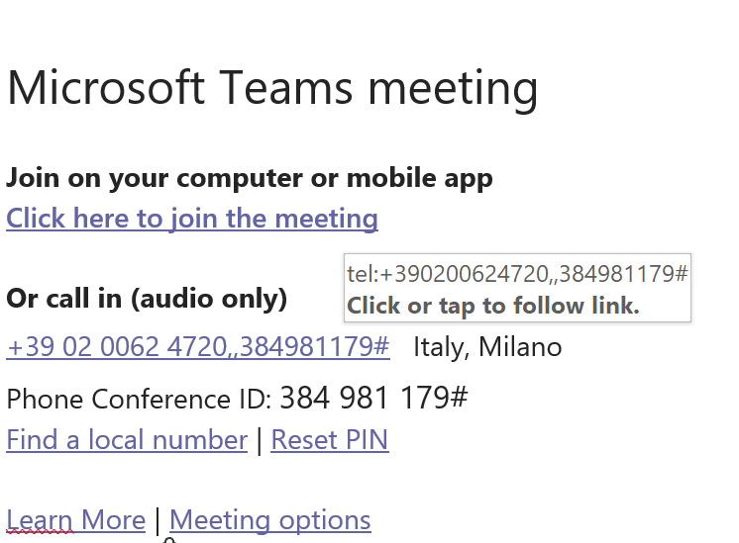

Slide 6
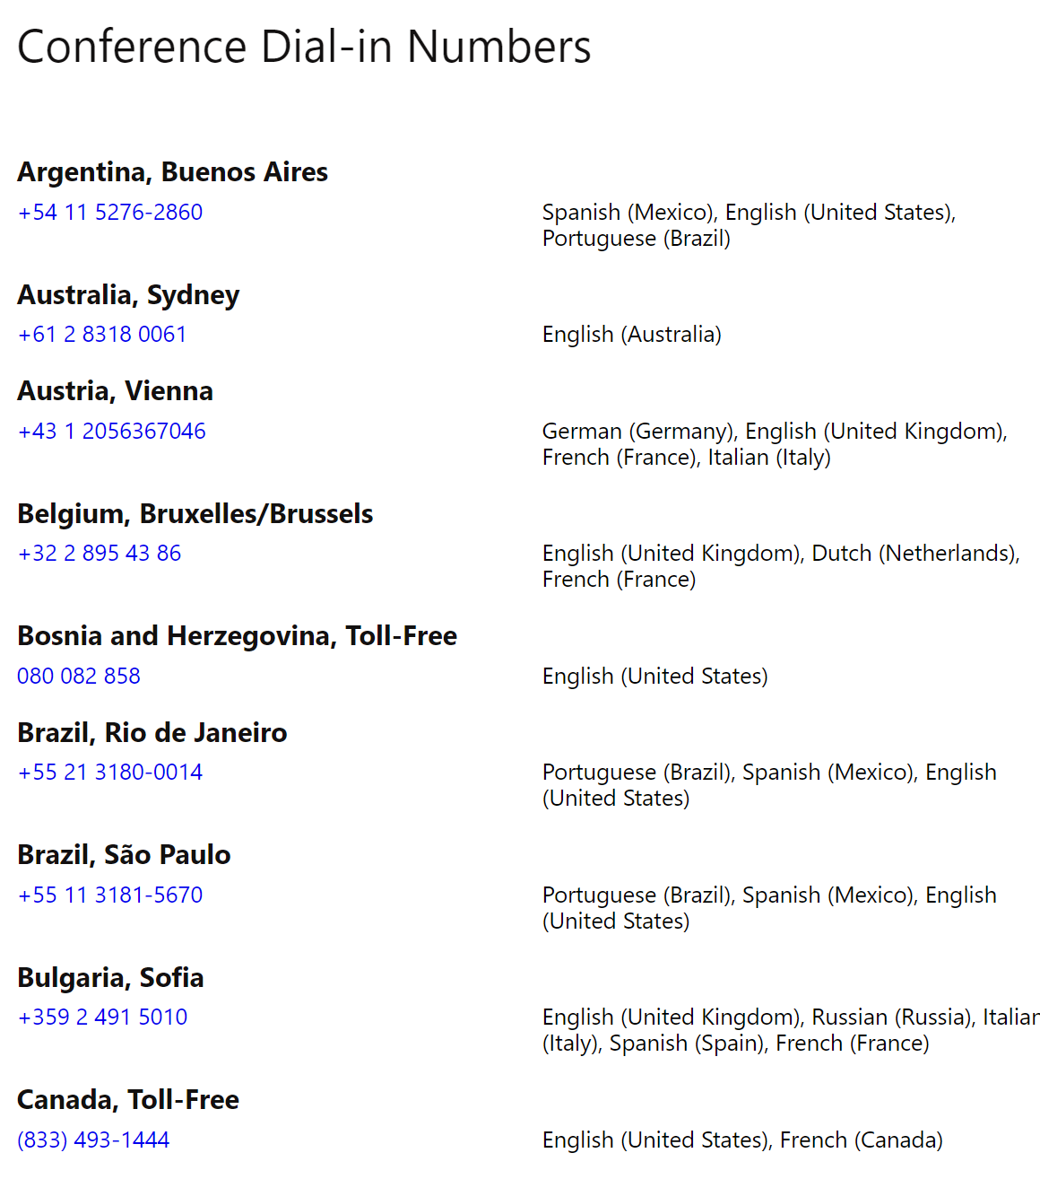

Slide 7
Audio Conferenza recap
 | Audio Conferencing
Inbound Conferencing | Incluso
Dial Out Conferencing verso Paesi di Zona A | 60 minuti / utente / mese raggruppati a livello di tenant¹
Dial Out Conferencing verso Paesi Pay As You Go | Communications Credits
Toll Free Dial-In
¹I 60 minuti / utente / mese raggruppati a livello di tenant verranno applicati a partire dal 1 ° dicembre 2019 (dopo il 30 novembre 2019, il periodo di introduzione delle audioconferenze con chiamate gratuite verso i paesi inclusi). I minuti di chiamata in uscita aggiuntivi verranno addebitati al minuto utilizzando i crediti per le comunicazioni. Nota: questa modifica non interesserà i clienti in Russia, Corea del Sud e Taiwan fino a quando i crediti per le comunicazioni non saranno disponibili in tali paesi.

Slide 8
Prima di parlare di Phone System alcune basi sulla telefonia
Notes:
If you do not have a foundation in telecommunications it is highly encouraged you take the time to familiarize yourself with the below terminology that is used in the telecommunications industry.
Basic Telephony Terminology
PSTN Public Switched Telephone Network
The public telephone network to which telephones, ACDs, and PBXs are connected. Also known as the network cloud.
Centrex
Centrex is a single line service delivered to individual desks/users with added features. Centrex is an alternative to buying/leasing a PBX or key system and is often most cons-effective for very small sites and very large campuses. Call handling with Centrex is virtually the same as with a PBX except that most of the components are in the central office.
Switch
A telephone exchange (US: telephone switch) is a piece of equipment that connects phone calls. It is what makes your phone calls "work" in the sense of making connections and relaying the speech information
Central Office
Phone company facility where subscribers lines are joined to switching equipment for connecting subscribers to each other, locally or long distance.
Private Automatic Branch Exchange (PABX, PBX)
PBX
A premise based solution (as opposed to central office hosted) that is owned/leased by the customer and is a smaller version of a telephone company central office switch. The PBX switches or connects lines to trunks. It has an attendant to provide serve to a number of individual phones, such as in a hotel, university, business, or government office. Most PBXs can support up o thousands of users and can be networked to other PBXs (of the same vendor type) to provide some level of transparency between locations and ease of use.
Trunk
A physical link (wire, optical line, and so forth) between telephone exchanges (switches)
TDM
A technique for transmitting a number of separate data, voice, and /or video signals simultaneously over on communications medium. In TDM, you sample each voice conversation (8000 samples per second), interleave the samples, send them on their way, and then reconstruct the conversations at the other end. Each sample is transmitted at a different moment in time and consumes the entire bandwidth of the pathway for that moment. TDM can be used for either analog or digital transmission. One measure of capacity in a system (e.g. T1) is the number of simultaneous conversations (timeslots) it can handle (create). The basic goal of time division multiplexing is to save money-put more conversations onto fewer lines/pathways.
VoIP
IP Telephony, also called 'Internet telephony', is the technology that makes it possible to have a telephone conversation over the Internet or a dedicated Internet Protocol (IP) network instead of dedicated voice transmission lines
CSTA over SIP
Computer Supported Telecommunications Applications (CSTA) In short, A standards-based protocol-level integration
ISDN
Is a digital standard used mainly in the US between PBXs and other PBXs, ancillary equipment or PSTN, additionally ISDN phones are widely used in Europe.
Integrated Services Digital Network (ISDN) is a type of circuit switched telephone network system, designed to allow digital (as opposed to analog) transmission of voice and data over ordinary telephone copper wires, resulting in better quality and higher speeds, than is capable with analog systems. More broadly, ISDN is a set of protocols for establishing and breaking circuit switched connections, and for advanced call features for the end user.
Pulse Code Modulation (PCM)
Legacy signaling standard
Dual-tone multi-frequency (DTMF),
also known as Touch Tone® is used for telephone signaling over the line in the voice frequency band to the call switching center. DTMF is an example of a multi-frequency shift keying (MFSK) system. Today DTMF is used for most call setup to the telephone exchange, at least in the Western world, and trunk signaling is now done out of band using the SS7 signaling system. The trunk signaling tones were different than the tones known as touch tone with a triangular matrix being used rather than a square matrix. See: blue box for more details on the switching tones.
Prior to DTMF the phone systems had used a series of clicks on the phone line to dial numbers, a system known as pulse dialing. The clicks were actually the connection of the calling party's phone line being made and broken, like flicking a light switch on and off. This was useful only as far as the local end office where the wires stopped, requiring operator intervention for long distance dialing.
CTI
Computer telephony integration, also referred to as CTI, is technology that allows interaction on a telephone and a computer to be integrated or coordinated.
Third-party-call-control
Third party call control generally requires a dedicated Telephony Server to interface between the telephone network (PBX) and the computer network.
Caller ID (Caller Identity Display or CID) is a telephony network service that transmits the caller's telephone number to the called party's telephone equipment during the ringing signal or when the call is being set up but before the call is answered. Typically, CID is transmitted digitally between the first and second rings.
Caller ID is also known as Calling Line Identification (CLI) when provided via an ISDN connection to a PABX, while in some countries, the terms Caller Display, Calling Line Identification Presentation (CLIP) or just Calling Line Identity (CLID) are used. CID originated with automatic number identification (ANI) in the U.S.
ANI Automatic Number Identification
A system utilized by telephone companies to identify the directory number (DN) of a calling subscriber. Similar to Caller ID, but based on different underlying technology. Though subscribers can block Caller ID, ANI is usually impossible to block. ANI data is usually transmitted in-band using multi-frequency signaling.
DNIS Dialed Number Identification Service
A feature that identifies the phone number the caller dialed to reach the answering telephone system. May be a number translation, depending on the dialing plan.
DN
Directory Number (VDN, CDN, etc vendor specific) think in terms of this being an extension/telephone/user
E.164
A 16-digit numbering scheme that provides a unique telephone number for every subscriber in the world. Think of this as the “telephone number”.
IP-to-PSTN Gateway
Aka IP Gateway. A bridge between traditional circuit-switched telephony and the internet that enables IP based solutions to connect to the PSTN network
SIP URI
SIP Uniform Resource Identifier. The SIP URI used in the configuration of Communicator contains the users phone number or extension along with the phone domain for the PBX to which they are associated
Example: +16504665120@DCOAlcatelA4400.genesyslab.com
TEL URI
Telephony Uniform Resource Identifier

Slide 9
Configurazione di una distribuzione PBX tradizionale
Connectivity
PSTN
End points
PBX
Trunk
End points e client
Gli endpoint e i client utilizzano le funzionalità del PBX
PBX è un sistema di fonia
Il PBX fornisce funzionalità vocali ai propri utenti
Collega (cambia) le chiamate tra gli utenti
Invia / riceve chiamate a / dal PSTN
Trunk
Connette il PBX alla rete PSTN

Slide 10
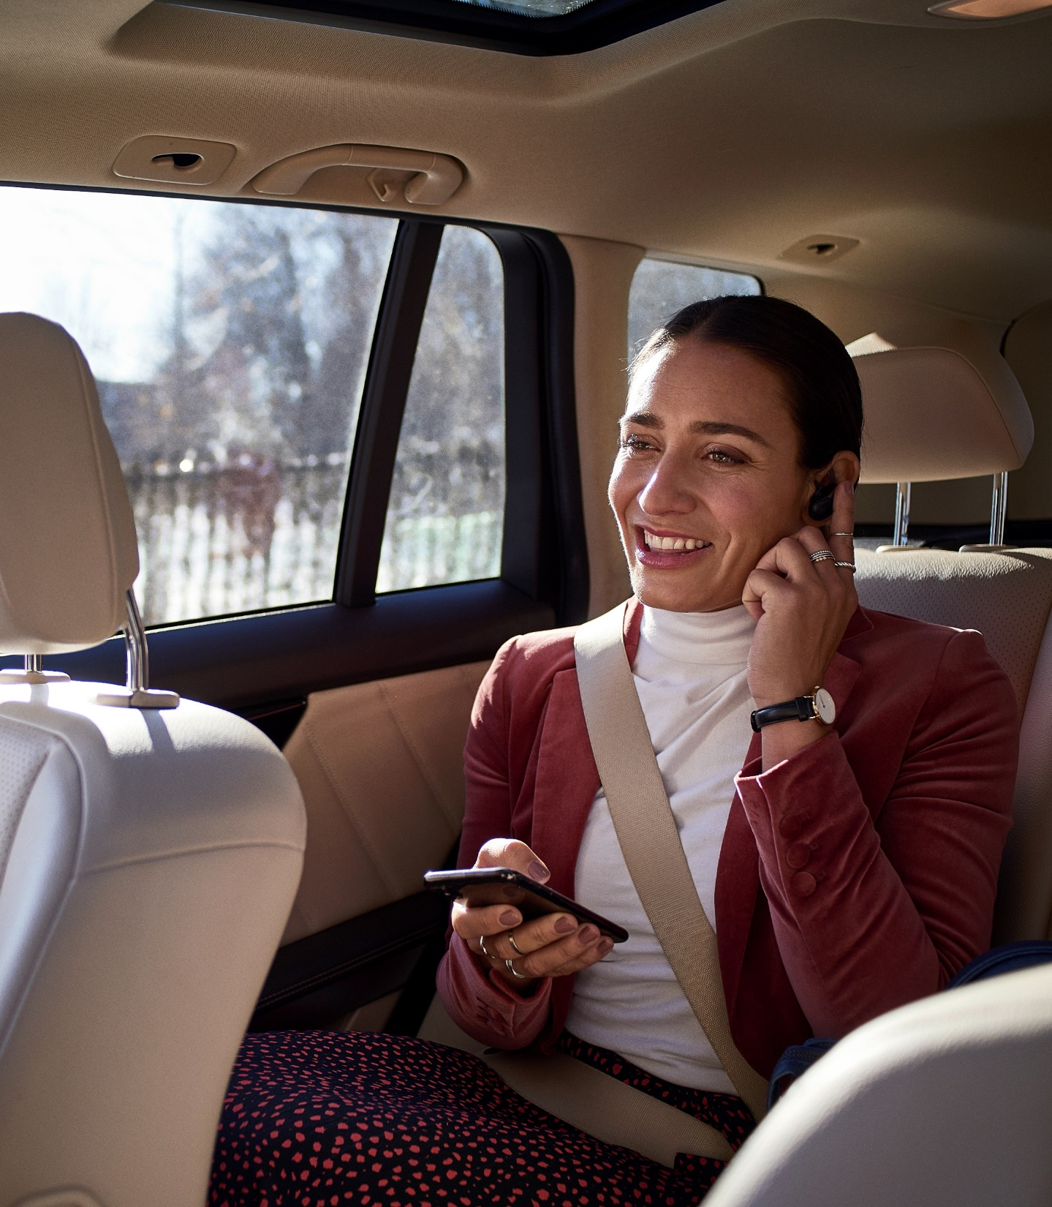
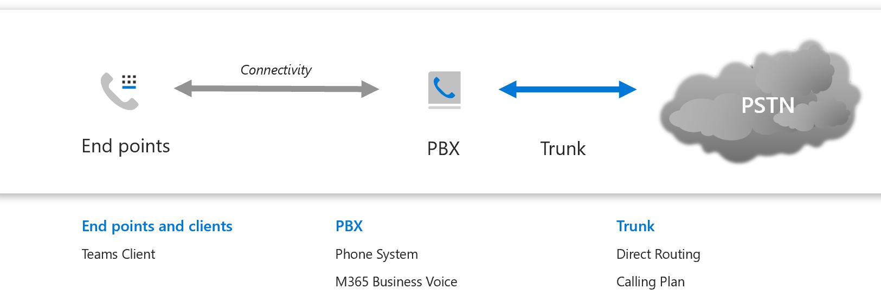
Portare la voce nel Cloud con Microsoft 365
Endpoints e clients
  Tutti i clienti di Teams – Windows, Mac, Web (currently Edge only), iOS, Android, IP Phones
  Sono in grado di sfruttare le funzionalità PBX oltre ad altre funzionalità di Teams
  Phone System and M365 Business Voice forniscono le funzionalità PBX
  Per tutti gli utenti di Teams con licenza appropriata
“Trunks”
  Calling Plan
  Direct Routing

Slide 11
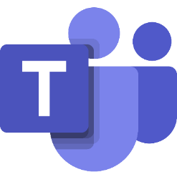
Semplifica le chiamate con Microsoft Teams
Microsoft Teams
PBX
Phone System
Usa i piani per chiamate Microsoft o il routing diretto per offrire un'esperienza di chiamata completa su scala globale
PSTN dial tone
Microsoft
Calling Plans
Direct Routing in Teams
(Telco Calling Services)

Slide 12
Che cos’è Phone System?
Features
Phone System consente agli utenti di effettuare, ricevere e trasferire chiamate da telefoni, cellulari, tablet e PC, utilizzando il provider di servizi telefonici, praticamente ovunque con accesso a Internet.
Effettuare, ricevere e trasferire chiamate di lavoro in ufficio, a casa o in viaggio, tramite telefono, PC e dispositivi mobili.
Interagire con le risorse esistenti ed eliminare sistemi telefonici PBX separati nel tempo
Aumentare l'agilità e consolidare la gestione con un provisioning rapido, la creazione di report e la diagnostica dei servizi vocali in Office 365
Office 365
Phone System
PSTN
Cloud Connectivity
Customer premises

Slide 13
Calling Plan + Direct Routing (tenant)
Calling Plan
Phone System
PSTN
network
Office 365 & Teams
Certified Session Border
Controller(s)
Direct Routing
Calling
Plan
Direct
Routing
Phone System offre due modalità per raggiungere la rete PSTN
In questo diagramma, in una si utilizza il Calling Plan e nell’altra si usa Direct Routing
Notes:
Slide title: Calling Plan + Direct Routing (tenant)
Slide notes:
First, it is important to understand Calling Plans and Direct Routing in detail.
On this slide, one company uses two options without co-existence. There are two types of users using either Calling Plans or Direct Routing. The systems are discrete. All PSTN calls for users with Calling Plans are made via the Calling Plans, while calls for users with Direct Routing are made via Direct Routing.
If a Teams user with a Calling Plan calls a user with Direct Routing, the call will be converted to Voice over Internet Protocol (VoIP) and the connection will be established between two clients without going to the telephony network.

Slide 14
Che cos’è Calling Plan?
Caratteristiche Calling Plan
Se combinato con Phone System, Calling Plans può diventare il vostro sistema telefonico completo.
Calling Plans fornisce ai dipendenti un numero di telefono (nuovo o esistente) e consente loro di effettuare e ricevere telefonate al di fuori dell'organizzazione.
Domestic Calling Plan
Gli utenti con licenza possono chiamare i numeri situati nel paese o nell'area geografica in cui sono assegnati in Office 365²
Domestic and International Calling Plan
Gli utenti con licenza possono chiamare i numeri situati nel paese o nell'area geografica in cui sono assegnati in Office 3652 e ai numeri internazionali in 196 paesi/regioni
Con i Calling Plans, agli utenti possono essere assegnati numeri di telefono esistenti o ottenere quelli nuovi
²See the Users can make outbound calls to these countries and regions table.
If customers require more minutes than are included in the Calling Plans, they will require a Communications Credits account.

Slide 15
Che cos’è il Direct Routing
PSTN
Provider
Certified Session Border
Controller(s)
Phone #
Ranges
Internet
Phone System
Voice Trunk
Office 365/Microsoft 365 & Teams
3rd Party Voice Apps
(supported by certified
SBC Partners)
Indirizza direttamente il segnale di linea agli utenti di Teams
Direct Routing in Office 365 consente ai clienti di connettere i propri trunk SIP direttamente dalla rete. I clienti possono collaborare con il proprio provider di telecomunicazioni locale per consentire agli utenti di Microsoft Teams di effettuare e ricevere chiamate telefoniche.
Interoperabilità con sistemi di terze parti
Direct Routing consente ai clienti con utenti nel cloud Microsoft di continuare a utilizzare sistemi di terze parti come PBX, Call Center e ATA (Analog Telephony Adapters), contribuendo a preservare gli investimenti chiave.

Slide 16
Valorizzare Teams con Voce e Audioconferenza
Microsoft 365
Modern Work
Microsoft Teams: Call & Meet app to app
Cloud PBX
Phone System: Calling over PSTN
Audio Conferencing
Audio Conferencing: Dial-in meetings
Microsoft 365 Business Voice
PSTN Dial Tone
Microsoft
Calling Plans
Direct Routing
(Telco Calling Services)
¹Microsoft Teams is included in Microsoft 365 suites
²Business Voice is an add-on

Slide 17
Confronto tra Business Voice e Enterprise Voice
Tutte le stesse caratteristiche e funzionalità
 | Business Voice |  | Enterprise
Admin | SMB specific setup wizard SMB specific calling rules
# utenti | 1-300 users |  | Unlimited users
Prerequisiti | Any Microsoft 365 plan with Teams |  | Most Microsoft 365 plans with Teams (not available on SMB plans)
Disponibilità: Microsoft Calling Plans | 3 markets (US, UK, CA) |  | 16 markets (US, UK, CA, BE, FR, DE, IE, PR, NL, ES, DK, AT, IT, PT, SE, CH)
Disponibilità: Senza calling plan (Direct Routing) | 70+ countries (everywhere audio conferencing is available) |  | 120+ countries (everywhere Microsoft 365 is available)

Slide 18
Offerte aggiuntive di Teams per le suite Microsoft 365 e Office 365
 | Office 365 |  |  |  | Microsoft 365 |  |  |  |  |  | Price
 | F3 | E1 | E3 | E5 | Business Basic and Standard⁶ | Business Premium⁷ | F1 | F3 | E3 | E5
Audio Conferencing¹ | + | + | + | ● | + | + | + | + | + | ● | $4
Phone System | + | + | + | ● | N/A | N/A | N/A | + | + | ● | $8
Domestic Calling Plan¹ | +² | +² | +² | + | N/A | N/A | N/A | +² | +² | + | $12³
International Calling Plan (includes Domestic) ¹ | +² | +² | +² | +($12) | N/A | N/A | N/A | +² | +² | +($12) | $24³
Business Voice⁴ | + | + | + | + | + | + | + | + | + | + | Geo-specific
Advanced Communications⁵ | + | + | + | + | + | + | + | + | + | + | $12
● = Included
+ = Can be added
N/A = Not available
²Phone System required
Microsoft confidential: Internal and partner use only
Notes:
¹Availability and included minutes may vary by region. To verify service availability, refer to https://docs.microsoft.com/en-us/microsoftteams/country-and-region-availability-for-audio-conferencing-and-calling-plans/. Consumption charges may apply for additional services, such as toll-free, international minutes for domestic plans, etc. Customers can disable these features to avoid additional billing.
²Phone System required
³Tax is included in price in the US and Puerto Rico. Service usage limits exist to manage fraud, abuse, excessive use, and maintain service performance.
⁴300 seat maximum. Limited geo availability
⁵Available beginning 8/1/20.
⁶Formerly named Office 365 Business Essentials and Office 365 Business Premium
⁷Formerly named Microsoft 365 Business

Slide 19
Quali sono i vantaggi di Teams Meeting e Calling?

Slide 20
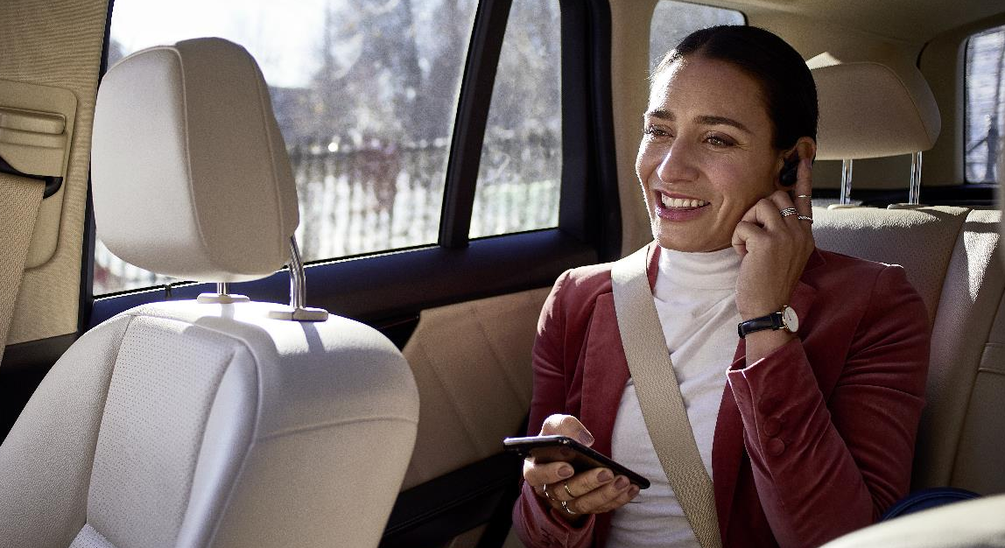
Chiamare diventa facile
con Microsoft Teams

Slide 21

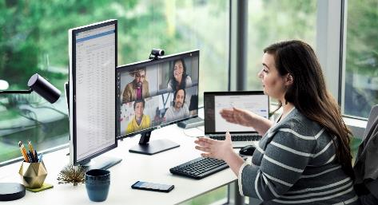
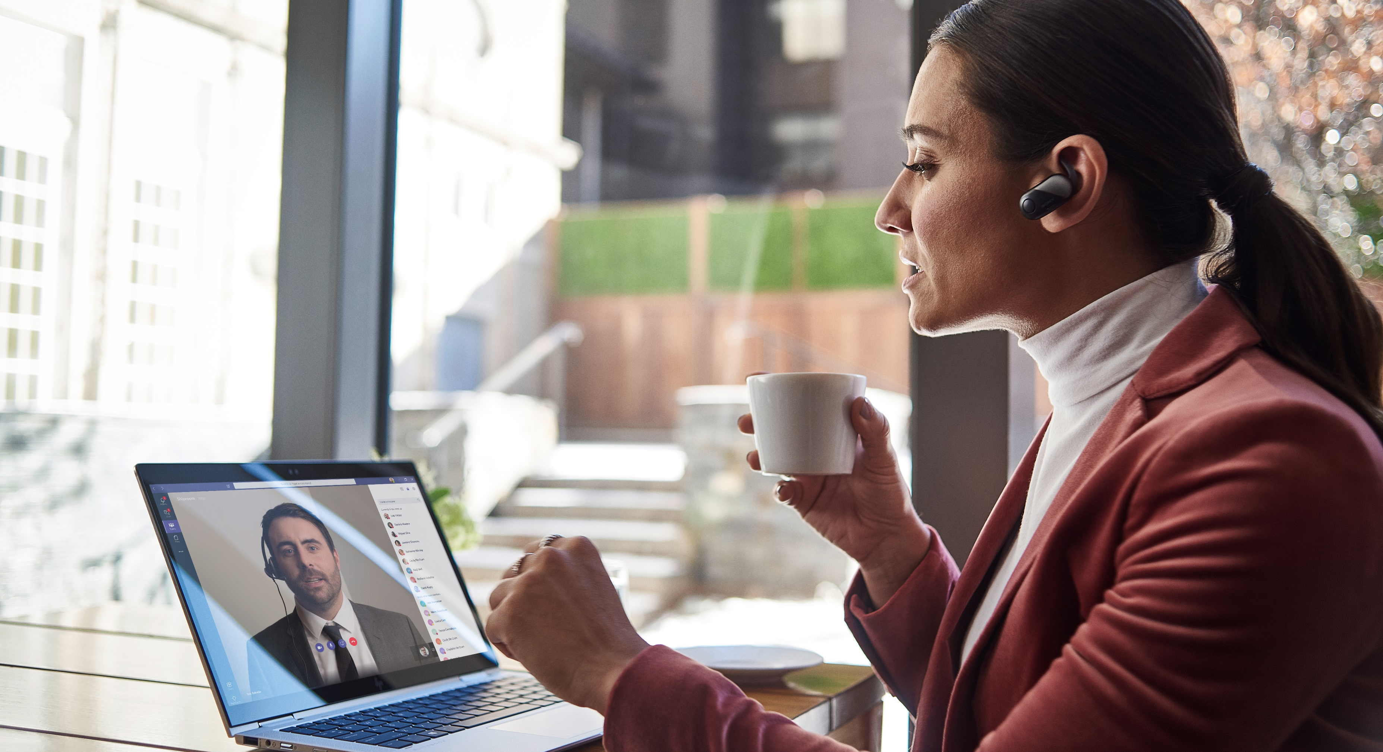
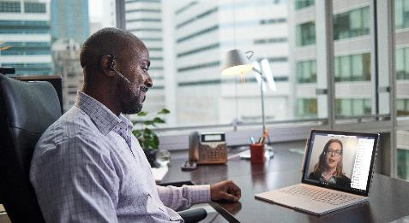
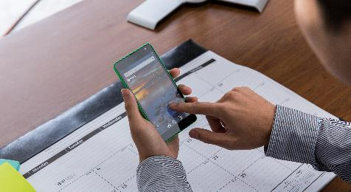
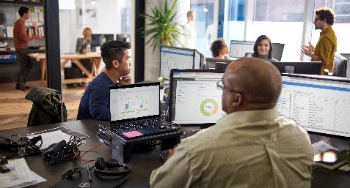


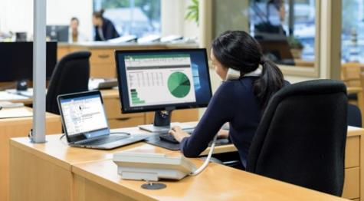


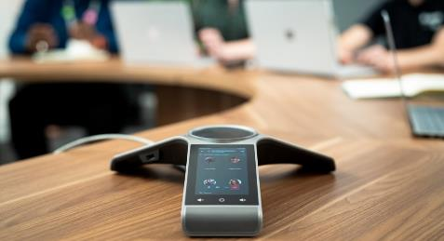
PBX
Online meetings
Audio conferencing
Telephony
Instant messaging
File sharing and
co-authoring
Essere connessi
in tempo reale è essenziale
Call forwarding
Microsoft Teams
mette insieme tutto quello che serve
Customer service
Calling attendants and Call Queues
Mobile calls
Task and project management
Conference room systems

Slide 22
Microsoft è un leader affidabile nella collaborazione
200 milioni
Utenti Meeting al giorno
20
organizzazioni hanno
100,000+ di utenti attivi
94+
Paesi con distribuzione di Direct Routing in utilizzo attivo
Leader
nel report Gartner’s 2020 UCaaS Magic Quadrant
Leader
nel The Forrester Wave Unified Communications-as-a-Service

Slide 23
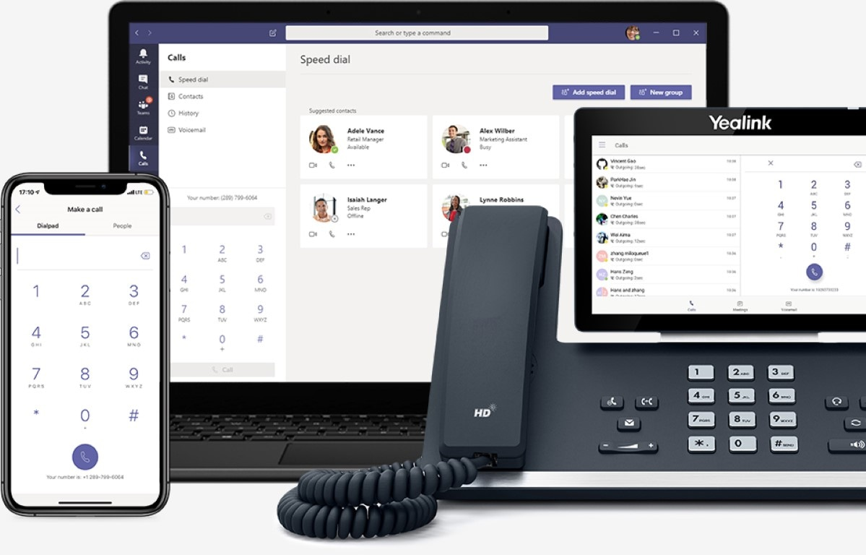
Microsoft Teams
Chiamare diventa facile
Sistema telefonico affidabile e di alta qualità
Microsoft Calling Plans o porta la tua Telco
Costruito sul cloud Microsoft 365

Slide 24
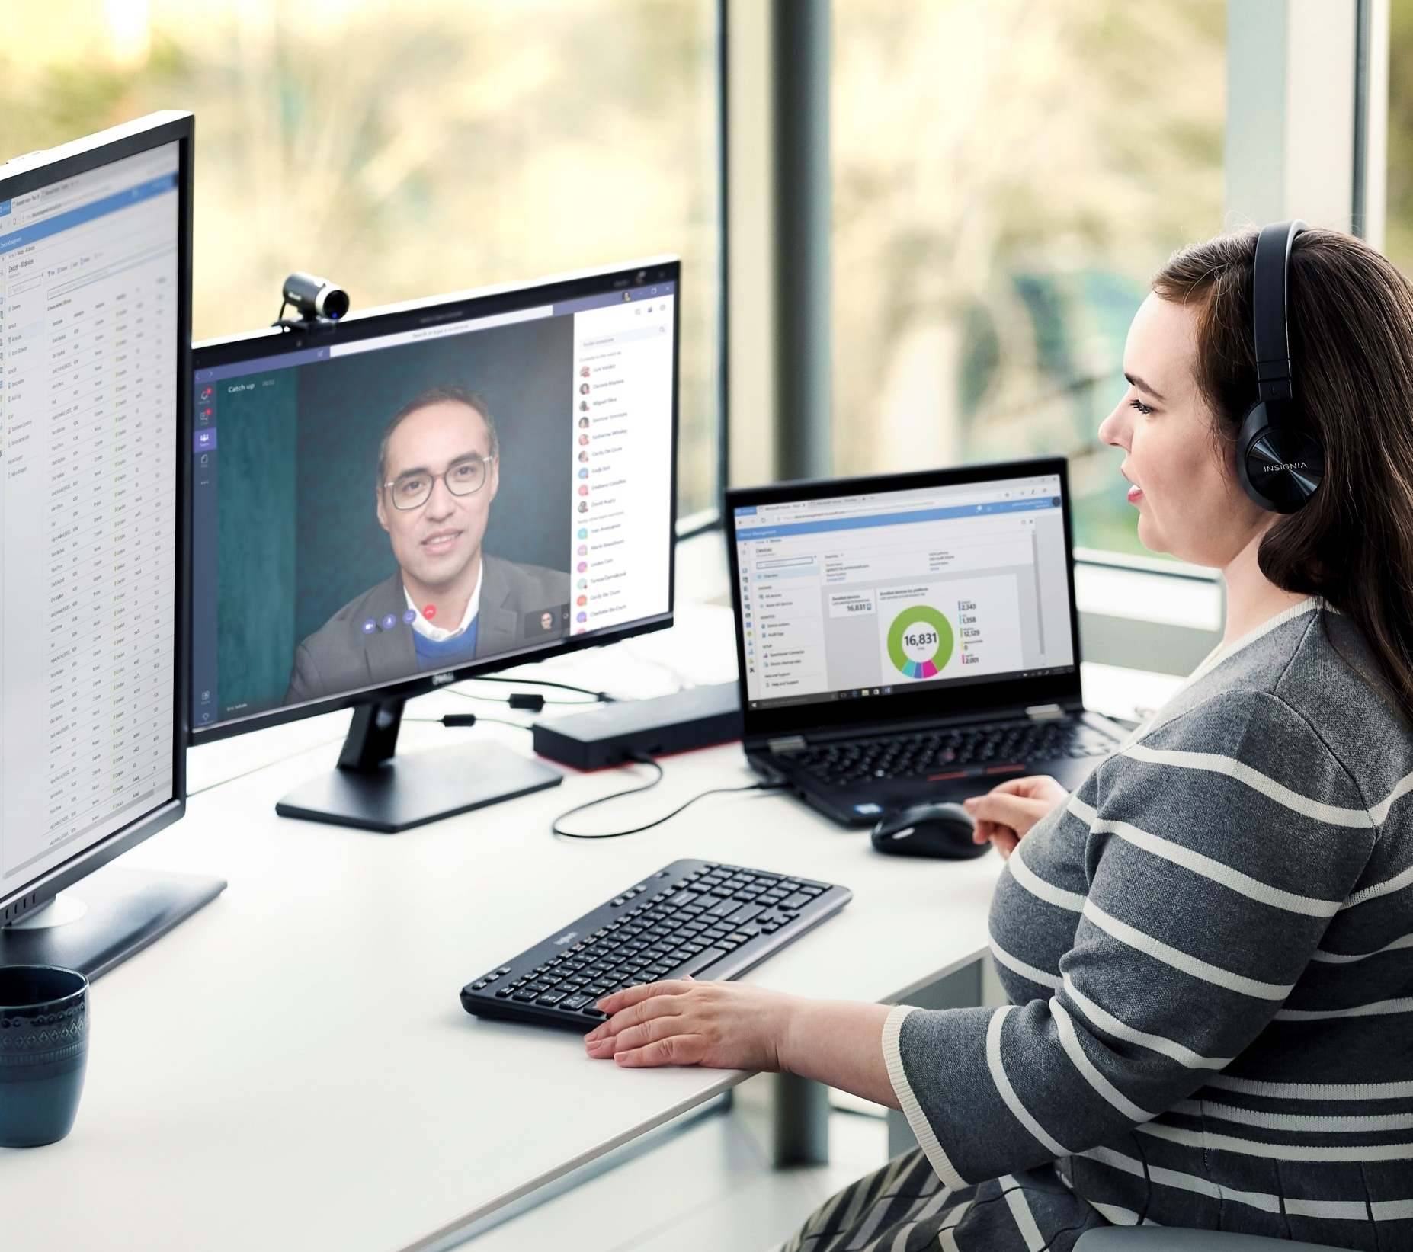

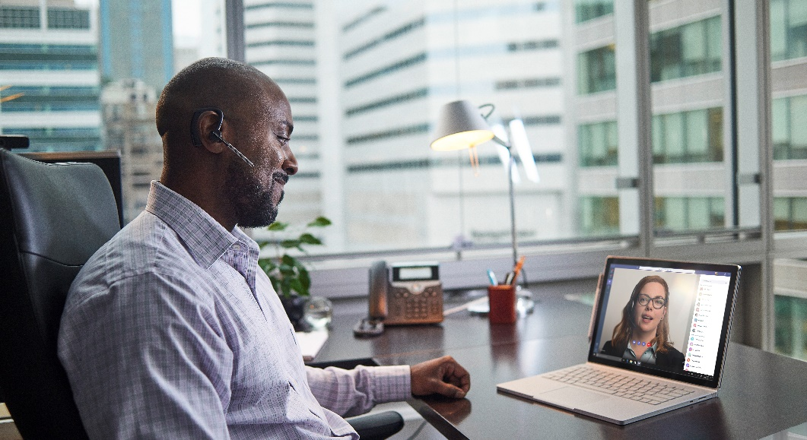
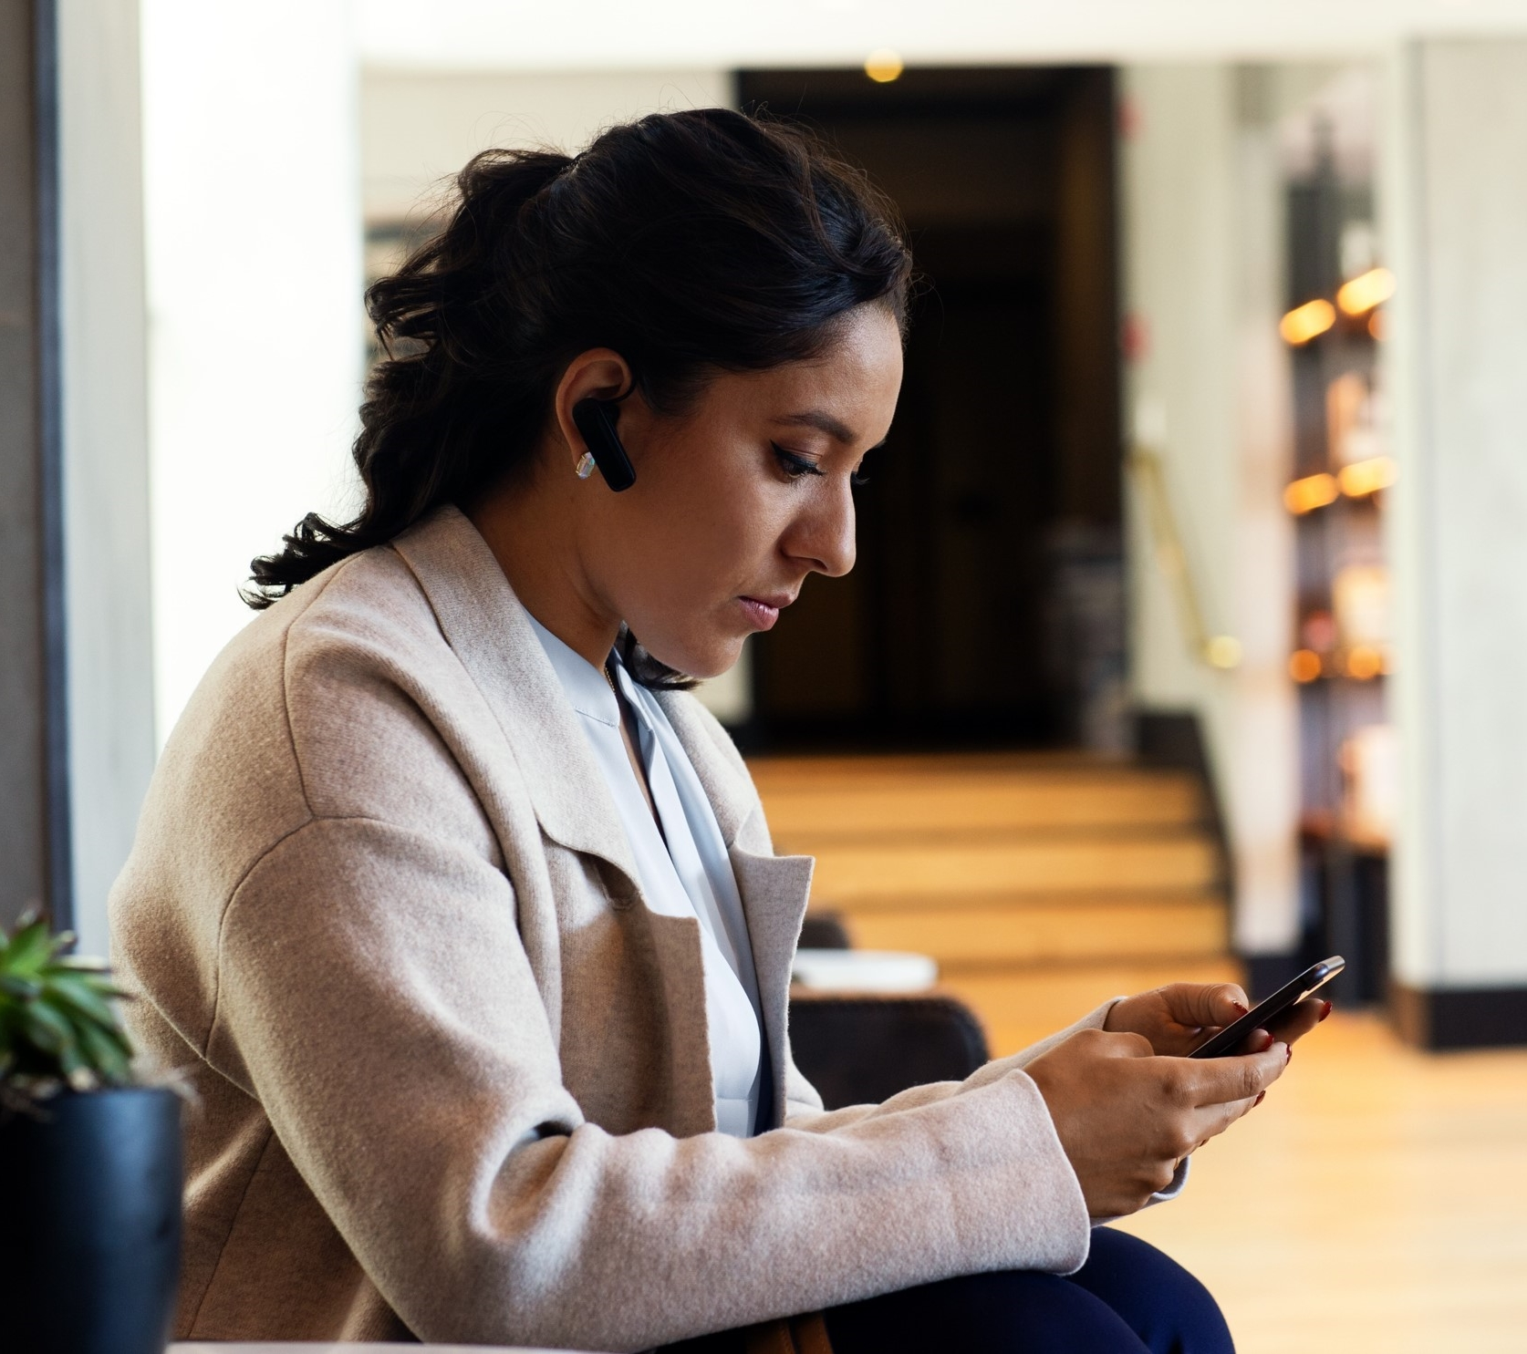

Chiamare diventa facile
Semplifica le comunicazioni con una soluzione all-in-one
Chiama dappertutto, da qualsiasi dispositivo
Offri funzionalità di chiamata avanzate
Semplifica la configurazione e la gestione

Slide 25
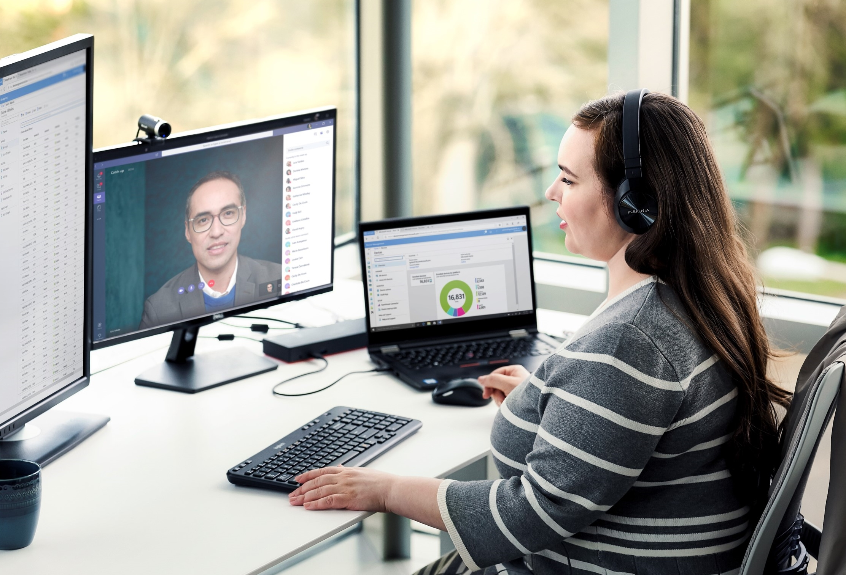

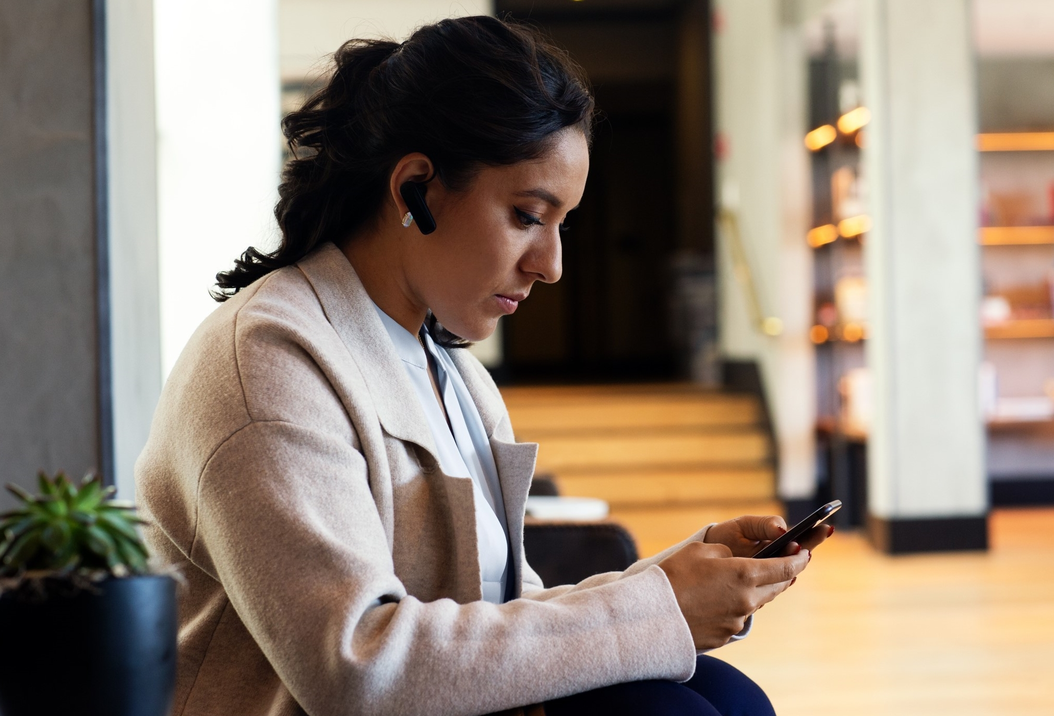
Chiamare diventa facile
Semplifica le comunicazioni con una soluzione all-in-one
Chiama dappertutto, da qualsiasi dispositivo
Offri funzionalità di chiamata avanzate
Semplifica la configurazione e la gestione
Lavora in modo più intelligente riunendo chiamate, chat e riunioni in un'app all-in-one.
Avvia rapidamente una chiamata da Teams, Outlook o dal tuo dispositivo mobile.
Collabora nelle app di Office all'interno di chiamate e riunioni.
Rimani connesso con un unico numero di telefono su computer, dispositivi mobili e telefono fisso.
Trasforma una chiamata in una riunione di gruppo senza riagganciare o ricomporre il numero.
Scegli tra una gamma di dispositivi personali e condivisi creati per i team.
Resta produttivo con le regole di risposta alle chiamate e la segreteria telefonica cloud per filtrare le chiamate
Puoi contare su funzionalità di chiamata cloud come trasferimenti, musica in attesa, coda di chiamate e altro ancora.
Lavora in squadra con la risposta alle chiamate di gruppo, la delega e la presenza di una linea condivisa.
Risparmia tempo e denaro con un unico provider per tutte le tue comunicazioni.
Aggiungi facilmente numeri di telefono con l'interfaccia di amministrazione Teams
Monitora e risolvi i problemi di prestazioni con Call Analytics e Call Quality Dashboard
Utilizza gli assistenti automatici e le code di chiamata integrati o connettiti facilmente al tuo software di contact center preferito.

Slide 26

Dispositivi Microsoft Teams
Comunica in maniera intelligente
Modi più intelligenti e veloci per connettersi e collaborare con i tuoi dispositivi
Costruiti con un obiettivo
Dispositivi ottimizzati per i tuoi spazi e stili di lavoro
Lavora in tutta sicurezza
Dispositivi certificati, con video e audio di alta qualità, sicurezza di livello aziendale e configurazione e gestione semplici
Office.com/teamsdevices
Una gamma di dispositivi certificati in ogni dimensione, per ogni spazio e stile di lavoro
Dispositivi personali
Dispositivi condivisi
Headset
Desk phone
Mobile phone station
Speaker puck
Mobile phone
PC
Conference
Room Phone
Microsoft Teams Rooms
Large screen collaboration device

Slide 27
Risorse disponibili

Slide 28
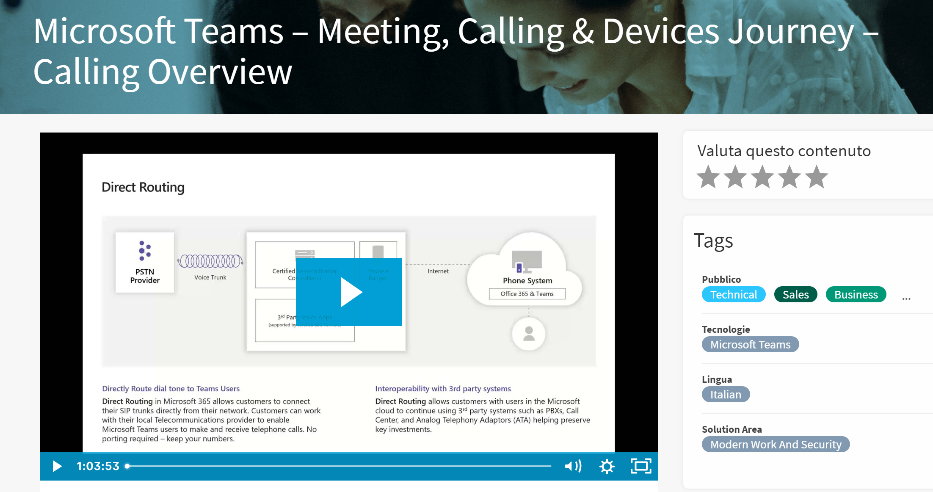

Slide 29
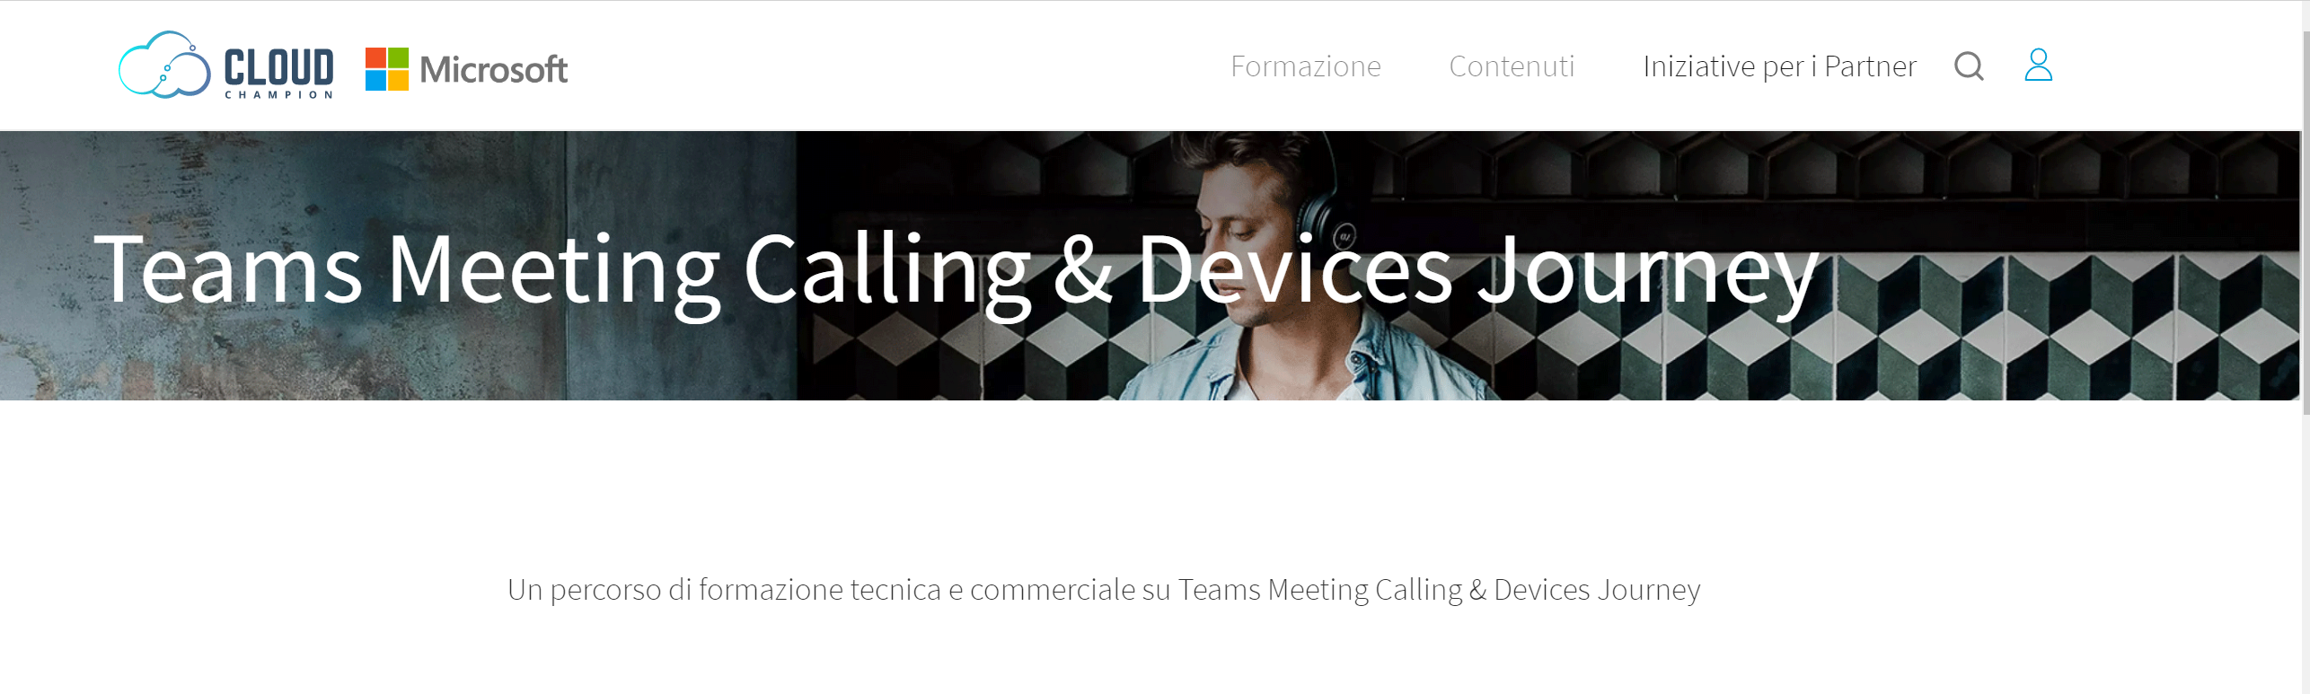
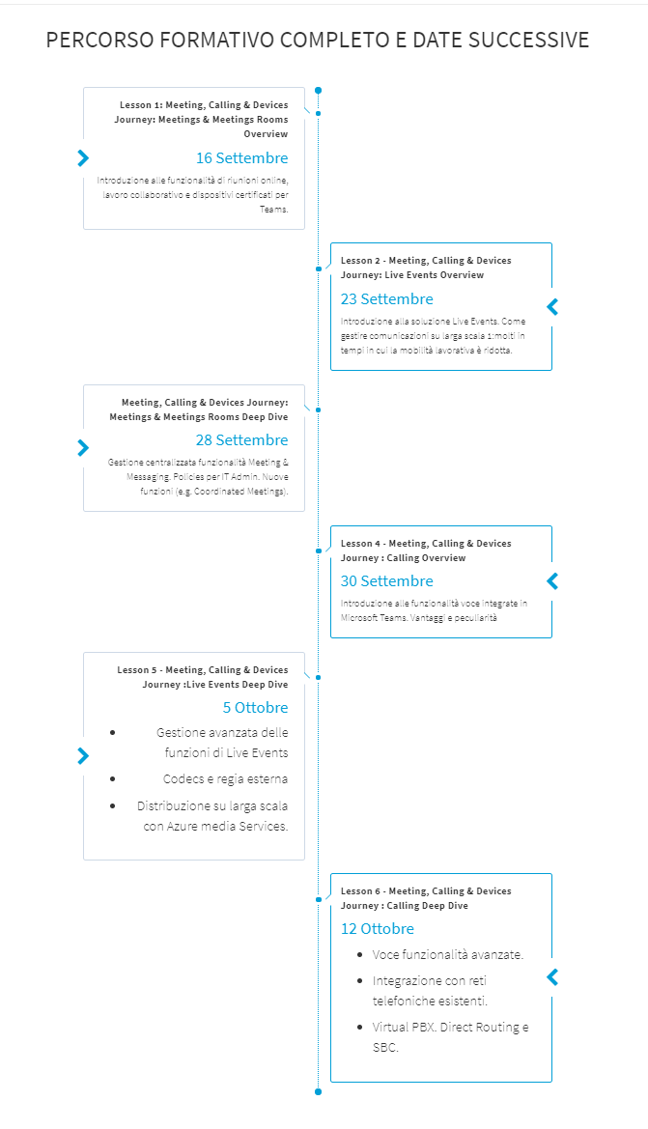

Slide 30
Grazie

