Slide 1
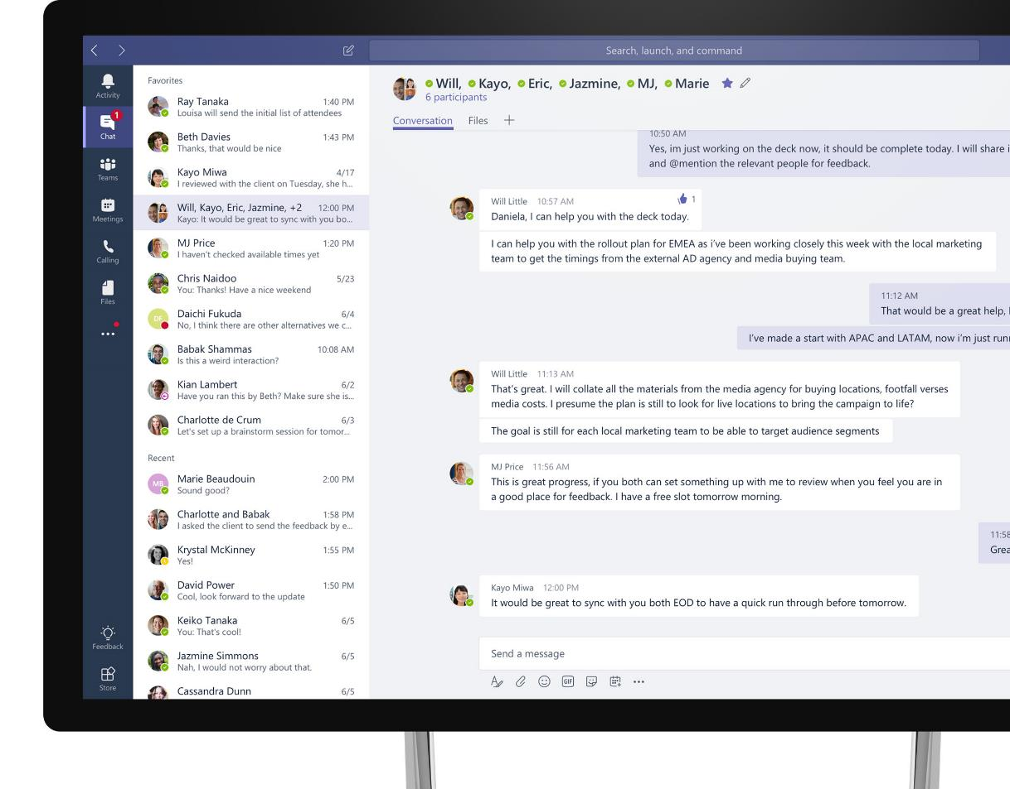

Rimani connesso con Microsoft Teams
{Presenter Name}
{Presenter Title}

Slide 2
Microsoft Teams è l’hub per il lavoro di squadra
Applicativi
Office
Persone
Contenuto
e creazione
Microsoft
Teams
Tutto ciò di cui hai bisogno per il tuo spazio di lavoro.
Tutto in un unico posto. Non importa dove tu sia.
Le app e
i servizi che usi
di solito
Chat,
Chiamate e
Meeting
Bot e
connettori

Slide 3

Chatta, incontra, chiama e collabora in un unico posto, indipendentemente da dove ti trovi – con Microsoft Teams
Semplifica le connessioni tra i dispositivi
Trasforma la collaborazione sul posto di lavoro
Rimani protetto con una sicurezza conveniente
Garantisci un'esperienza fluida e coerente con una qualità audio e video superiore
Connettiti con i dispositivi condivisi e personali certificati per Teams, tra cui Microsoft Teams Rooms e Surface Hub2
Integra il tuo sistema telefonico e le funzionalità di chiamata
Unifica la collaborazione sul posto di lavoro in un hub digitale in cui i team possono incontrarsi, chiamare e chattare
Aumenta la produttività remota ottimizzando i processi aziendali
Potenzia il tuo team organizzando riunioni 1:1, eventi di gruppo o conferenze virtuali più grandi
Riduci costi e rischi consolidando su un'unica piattaforma
Consenti ai team di sicurezza di coordinare protezione, rilevamento, risposta e prevenzione con un'unica soluzione
Garantisci conformità e governance a tutti i livelli

Slide 4



Sfrutta Microsoft Teams per connettere tutto il tuo lavoro, in un unico posto
Comunica in chat e riunione
Rimani in contatto con il tuo team utilizzando le funzionalità di chat e video
Collabora con Office 365 Apps
Personalizza l'area di lavoro e aumenta la produttività tramite file condivisi e app di Office
Lavora in modo sicuro e con fiducia
Accedi in tutta sicurezza, piena conformità
e facilità di gestione

Slide 5
Comunica attraverso la chat
Comunica facilmente e tieni il tuo team sempre aggiornato
Chat persistente e contestuale
Chat private 1:1 o conversazioni di gruppo
Condividi le informazioni in modo aperto e trasparente
Comunica tra le diverse aree geografiche
Rendi più empatica la conversazione con gif, adesivi ed emoji
Notes:
Microsoft Teams provides a shared workspace that enables teams to communicate without effort through chats - across geographical boundaries.
Chats are threaded, persistent and contextual allowing your team to stay in the know and easily understand the context of the conversation.
Today, teams are dynamic. Members, roles, priorities and goals can change, resulting in different communication needs.
[MAIN POINT TO LAND]
In Teams, people can choose how to communicate. They can engage in private 1:1: chats, in group chats or in team conversations that are visible to the entire team. Team conversations are open by default. Working in the open has a transformative effect on the culture of a team and helps organizations move from personal to team productivity.
We have recently added guest access, so you can now chat with everyone on your team, whether they’re inside your organization or an outside partner.
Teams allows you to have fun together. Successful collaboration is based on relationships. So, people can include emojis, memes and fun graphics in messages, which allows them to show their personality, and humanize messages.
Most teams have a fun channel to communicate about other topics than work. For example, when somebody joins the team, or has a baby – you can get to know the people beyond work interactions creating a culture of teamwork.
You can also use gifs, stickers, emojis to bring humor into the communication, and to soften messages. Changing the communication style can change the style of a team. You can worry less about formalities and focus more on the substance.

Slide 6
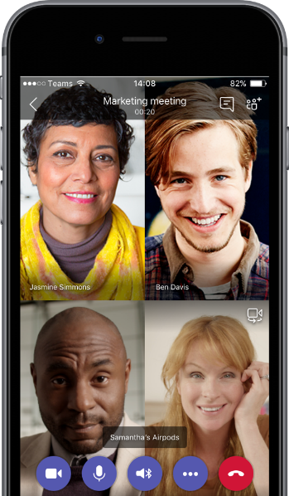
Esegui riunioni coinvolgenti e produttive
Comunica efficacemente e in tempo reale
Comunicare facilmente nelle riunioni online con VoIP e audioconferenze telefoniche con dial-in
Mantieni il tuo team coinvolto con i video HD
Collabora in tempo reale con la condivisione dello schermo e le app integrate
Partecipa su dispositivi mobili, desktop o in un browser Web
Avvia le riunioni istantaneamente con un solo clic

Slide 7
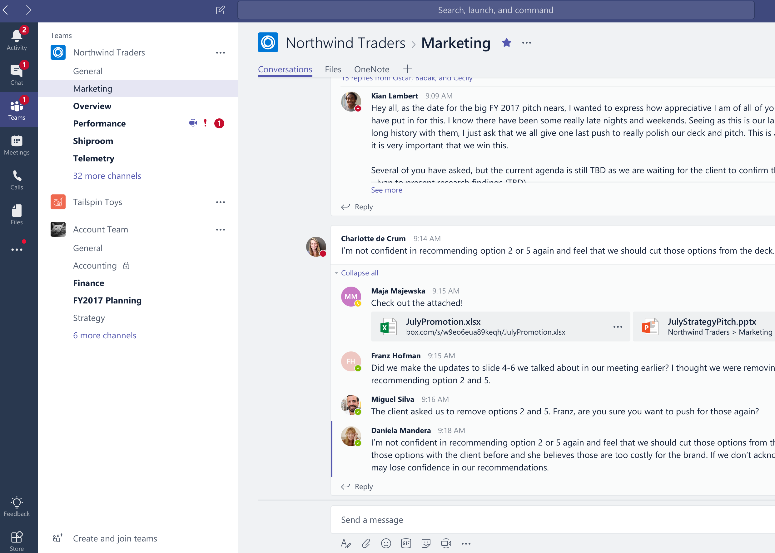
Collabora con le app integrate di O365
Accedi velocemente alle tue app preferite
Accedi alle tue conversazioni, file e strumenti in un'area di lavoro del team
Condividi e crea file in co-authoring nell'app
Sfrutta l'integrazione di SharePoint, OneNote, Power BI e Planner
Ricerca tra persone, file e chat
Mantieni aggiornato l'intero team con l'integrazione della email
Notes:
Information often lives across siloed services today – like mail, files, meetings, PowerBI/data, other SaaS services.
[MAIN POINT TO LAND]
Teams is a hub both for communication and collaboration that brings all these services together in one single workspace. So, teams have one less place to go to resulting in more time for productivity as you do not have to toggle between apps.
All your common tools, all the Office apps that people use every day - Word, Excel, PowerPoint, OneNote, SharePoint, even Power BI - are all built-in, giving people access to the files and tools they need right within Microsoft Teams.
Users can share, co-author and edit Office and other files right in the app. As all files are stored on SharePoint, the latest version of the file is always accessible to any member on the team. This enables organizations to democratize knowledge and give everybody access to the information they need to get their work done.
You can take notes with OneNote or access an integrated calendar from Outlook.
Microsoft Teams is also integrated with SharePoint, PowerBI and planner, so teams can work in a central place with all the necessary tools to pursue team objectives.
We’ve built integration with email, so users can forward an email into a Team’s channel for further discussion.
Microsoft Teams leverages the intelligence of the Microsoft Graph. A team member can access org chart information and do searches for contacts within an organization.

Slide 8
Personalizza ed estendi la collaborazione
Personalizza la tua area di lavoro per includere app e servizi di cui il tuo team ha bisogno
Metti in evidenza i file importanti per un facile riferimento nell'area di lavoro
Aggiungi bot che funzionano per conto del team
Integra i servizi di terze parti che il tuo team utilizza quotidianamente
Crea integrazioni nei processi aziendali esistenti
Gestisci app attendibili per i dipendenti e l'organizzazione
Notes:
[MAIN POINT TO LAND]
Every group is unique – both in structure and in style – so we have made it easy for teams to tailor their workspace to their needs and to include apps and services which are relevant to their team or project.
You can set up your channels so that conversations on certain topics happen in designated spaces
You can pin important files for quick reference for the whole team to access them in just one click.
You can add intelligent bots to interact with Microsoft Teams. Bots can answer natural-language questions and perform lightweight tasks such as FAQs.
You can bring in cloud services to explore data and get updates from Microsoft apps and 3rd party apps. Where 3rd party services are included, notifications can be customized so the team never misses a beat.
To bring our users a breadth of customization options, we’re working with more than 150 partners.
We have also created an extensible platform, to enable building apps with a rich set of capabilities to enable higher-performing teams. The Microsoft Teams developer platform enables integrations to your existing business process through publicly available APIs. IT can manage trusted apps for the employees and the organization.

Slide 9
Lavora in tutta sicurezza
Ottieni sicurezza, conformità e gestibilità integrate con Office 365
Cloud globale iper-scala, inclusa la possibilità di residenza dei dati locali
Leadership in conformità con EUMC, HIPAA e altro ancora
Protezione delle informazioni integrata con eDiscovery e audit
Autenticazione multi-fattoriale e accesso guest sicuro
Gestisci tutti gli aspetti in un'unica esperienza di admin coerente
Notes:
Finally, Microsoft Teams provides industry leading security and compliance capabilities and rich management capabilities.
With Microsoft Teams, customers benefit from the Office 365 hyper-scale, enterprise-grade cloud.
[MAIN POINT TO LAND]
From Day 1, the requirement has been for Teams to provide you with the same Office 365 capabilities that you’re used to and to build security, privacy and trust directly into the service.
You can manage and monitor all features in one centralized portal:
Data encryption at all times, at-rest and in-transit.
Customer data at rest remains in region
Ability to have local data residency for core customer data at rest, plus failover and disaster recovery (see data residency slide in the appendix for details)
Human back-up via on-call support engineers standing by 24×7
Customer content is never accessible in logs or telemetry
Multi-factor authentication for enhanced identity protection.
Secure guest access with AAD managed guest accounts
A big privacy topic for all our European customers is of course GDPR – the Global Data Protection Regulation. We will adhere to this ahead of the May 2018 deadline
Microsoft Teams supports key standards including SOC 1, SOC 2, EU Model Clauses, HIPPA, and more. Since preview, we’ve added mobile management with Microsoft Intune and new features for compliance and litigation support, including audit log search, eDiscovery and legal hold for channels, chats and files.
The Microsoft Teams admin center [coming early 2018] provides you with a single coherent admin experience where you can manage all aspects of Microsoft Teams including users, settings, and analytics.
Teams provides enterprise manageability to configure and set policies at a per-user level and manage trusted apps for employees and the organization.
PSTN connectivity in Office 365 will give you the option to connect existing on-premises investments in the future.
Advanced call management controls include call routing, auto attendant, call queues, and reporting.
While security and compliance are critical, our responsibility goes beyond this. Our mission talks about empowering every person to achieve more. With that in mind, we’re focused on building an inclusive experience, including support for those who use screen readers, high contrast, and keyboard-only navigation, to enable the collective brainpower and potential of everyone.

Slide 10
Contattaci per abilitare subito i tuoi meeting e le tue chiamate su Microsoft Teams!

